Slide 1
NetHealth Data

Slide 2
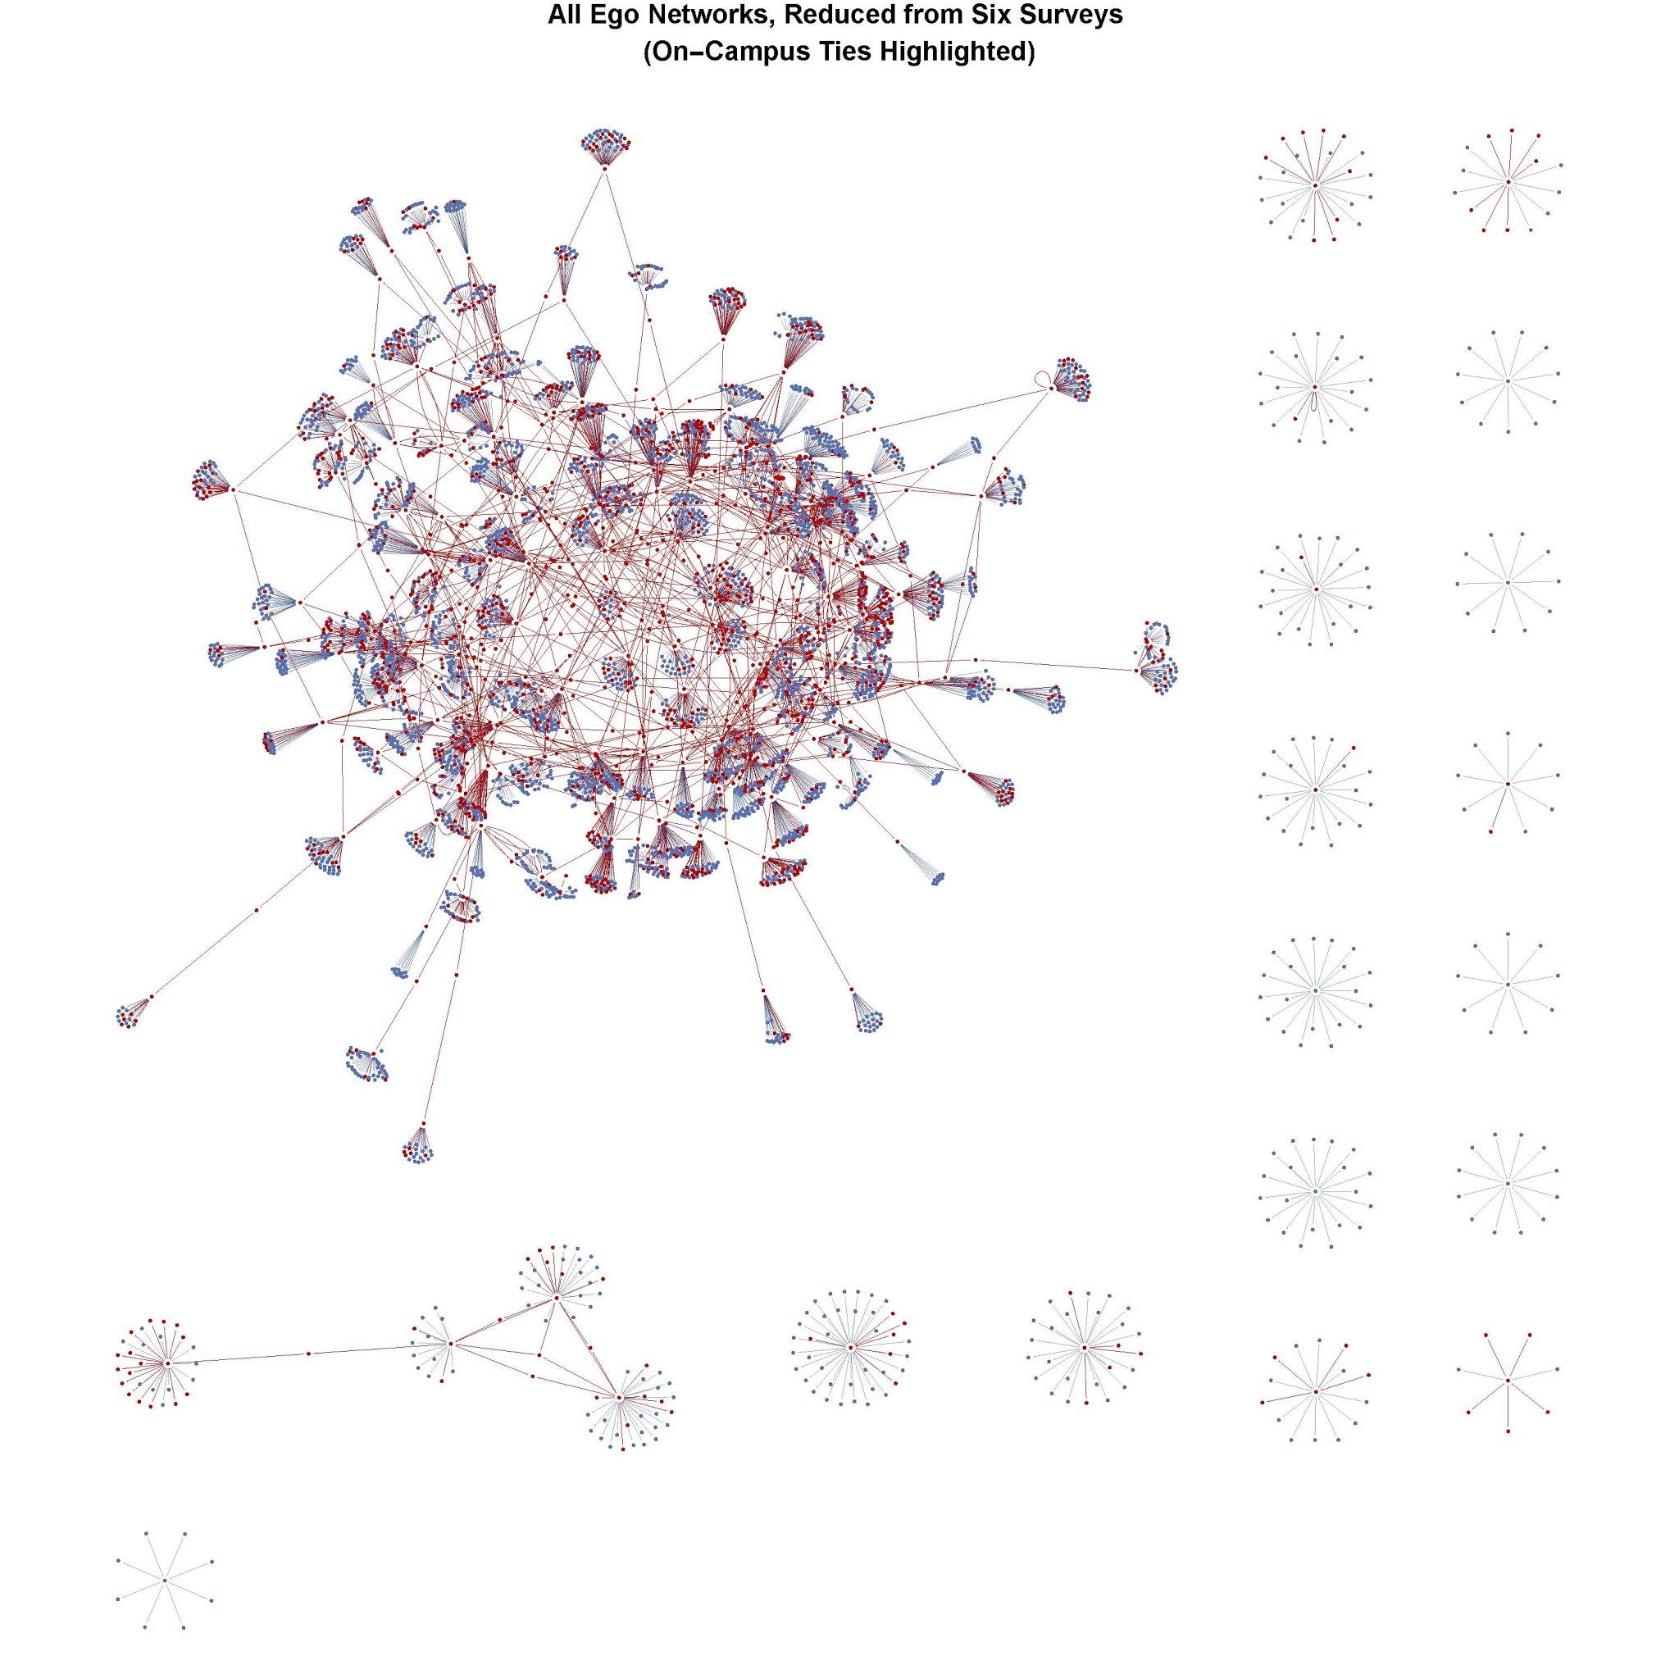
NetSense Study
2-year + data collection effort funded by NSF using CDRs obtained from smartphones
162 Notre Dame students, full data for 70 weeks
  6 million communication events
  55,000 alters
  25,000 mutual dyads, 13,000 with other ND students
  ~650 mutual dyads in which both persons are in NetSense study
No ties with other ND students prior to arrival, so students begin with no ND friends
Watch as people form ties within and between status groups
Striegel, Aaron et al. 2013. “Lessons Learned from the Netsense Smartphone Study.” Pp. 51–56 in Proceedings of the 5th ACM workshop on HotPlanet. ACM.

Slide 3
NetSense Data
Behavioral Event Data: Time-stamped communication event with to and from phone numbers
  Anonymized (Codebook)
Arc weekly data: 73k arcs (directed edges); within study, 1276 arcs
  Codebook
Basic (demographic) Survey
Network Survey
Courses and Grades Data
Suppl. material: coded clubs, activities, dorms; calendars

Slide 4
NetHealth
Objectives
  To collect a wide range of data at high temporal resolution on people’s social ties AND their behaviors, in particular physical activity and sleep habits.
  To model the co-evolution of ties and behaviors in order to test hypotheses about the explanation for nodal clustering in social networks.
NIH funded R01 grant. Large team. Multiple years.
Innovative Data
  Using remote mobile always-on sensors to gather data
  Also obtain “regular” social network data
  High temporal resolution - event data (time stamped)
Website: Data, Documentation sites.nd.edu/nethealth

Slide 5
Data Collection
Began in Summer 2015
3 Tiers. Total N = 698
  Tier 1 recruited prior to arrival at ND. N = 406
  Tier 2 recruited via recommendations of Tier 1. N = 94
  Tier 3 recruited February 2016, N = 222
  N = 24 took a survey, but never in study
Planned 2 year study
Variable compliance: Fitbit, Surveys, Data Syncs
Continued in Years 3-4 with smaller sample of higher compliance persons
Notes:
Attrition
Year 1, loss 28
Year 3 - 402
Year 4 - 253

Slide 6
Collected Data
Students given Fitbits. Data uploaded to Fitbit Cloud and retrieved
  Fitbits given to some students prior to arrival
Text and Call Data: Downloaded by user to computer, synced with our secure servers
  iPhone downloads have prior to ND events
  No content retained
Other phone data: App on phone, collects and transmits to servers
Basic Survey: administered every 3 months. Used Qualtrics
Network Survey: administered every 3 months. Used Qualtrics
  Ego network data: Asked people to list up to 20 alters
  Alter-Alter data
Grades and Courses: administrative data (N = 220)

Slide 7
Data ID codes and Linking
Vertex ID codes created for all vertices
  In-study participants
  Named alters through network surveys
  Contacts called/texted
Complicated procedure involving clustertering together all ID codes from various devices (Fitbit, phone) and sources (surveys) that are likely to be the same person
  Network surveys asked subject to report name, email, and telephone of each contact.
  Communication data used emails and phone numbers
  Fitibt data has Fitbit id codes linked to individuals who have a Fitbit
ID Code:
  5 digit = In Study
  6 = Named Alters
  7 = Unknown Other

Slide 8
Communication Data
Event time-stamped data
  Over 60 million communication records
  Codebook: egoid, alterid, date, time, outgoing
  Egoid is id for the person whose device recorded the event
  Variable outgoing allows user to reformat arc list so arcs are sender-receiver dyads
  Event types are coded in terms of calls, sms, mms, WhatsApp
    Most events (52m) are SMS
  Time series for events allows us to track arc evolution over time
Notes:
Show tableau workbook

Slide 9
Derivative (Aggregated) Data (Within Study Dyads)
Arcs/Edges list for specific time period (e.g. Fall 2015)
  Daily Arcs file: {i, j, date} records with frequency = number of events
  Weekly Arcs file: {i,j} records life of the tie information
    first and last week active
    Event frequency (weekly and cumulative; text and voice)
    Age in weeks
    Reciprocated
  Semester Arcs file
Weekly Nodes file: {i} records
    Effective degree
    Active alters count
    New alters count
    Dead alters count
    Growth in N alters
    Clustering coefficient
Notes:
Show daily arcs file in excel

Slide 10
Interaction Events and Social Networks
What is a social network?
  Sets of vertices and edges: G(N,M)
  When does an edge between two vertices exist?
  Social interaction event: e_{ij}(t_{k}) = 1
    communicative interaction
Social Network Dynamics
  Temporal pattern of the interactions
  Beginning and end to a sequence of interactions

Slide 11
Dating Social Ties: Effective and Active
Begin date: time of first interaction
e_{ij}(t_{k}) = 1 | e_{ij}(t<t_{k}) = 0 for all time points t < t_{k}
End date: time of last interaction
e_{ij}(t_{k}) = 1 and e_{ij}(t>t_{k}) = 0 for all time points t > t_{k}
Left and right censoring
Active Tie:
e_{ij}(t_{k}) = 1
Effective Tie:
x_{ij}(t_{k},t_{k+∆t}) = 1 if
    e_{ij}(t) = 1 at some point in time t prior to t_{k}
    e_{ij}(t) = 1 at some point in time t after t_{k}
Effective tie implies there could be interaction between i and j at any time between t_{k} and t_{k+∆t}

Slide 12
Network Survey Data
Used name generator
After Wave 2 fed back names as checks
Information on
  each alter (gender, race, education, age, religion)
  Each tie (how know, relation to ego, duration, frequency ,etc.)
Data
  Long file where records are edgelist by wave
Codebook
Notes:
Pdf and stata

Slide 13
Basic Survey Data
Summary of Variables and Scales (Basic Survey Comparison sheet)
  Background
  Demographic
  Education
  Mental Health (depression, anxiety, stress)
  Physical Health (and expectations)
  Social-Psychological Measures: self-esteem, regulation, personality, efficacy
  Activities
  Attitudes
  Usage
Information on scales and measures
Codebook
Codes (Clubs, Activities, Events; Health States)
Notes:
Show codebook
In stata data

Slide 14
Fitbit Data
Activity Data
Sleep Data

Slide 15
Other Data
Course and Grades Data
ND Event Calendar
Weather event calendar

Slide 16
Data
sites.nd.edu/nethealth

Slide 17
NetHealth Data Summary - Sections
About
Sample
Data Linkage and Identification
Communication Event Data
Basic Survey Data
Network Survey Data
Fitbit Data
Courses and Grades Data

Slide 18
NetHealth Data Summary - Data
Communication Data
Basic Survey Data
Network Survey Data
Network Alter-Alter Survey Data
Fitbit Activity Data
Fitbit Sleep Data
Courses and Grades Data

Slide 19
NetHealth Data Summary - Codebooks
Basic Survey
Network Survey
Alter-Alter Edge List
Communication Events
Fitbit Activity
Fitbit Sleep

Slide 20
NetHealth Data Summary - Tables & Supp. Material
Table 1: Attrition Counts
Table 2: Case Record Codes
Table 3: Communication Event Type Codes
Table 4: Basic Survey Questions by Wave
Table 5: Basic and Network Survey Questionnaires
Table 6: Basic Survey Scales
Table 7: Consolidated Activities & Clubs Coding Schema
Table 8: Musical Genres Codes
Table 9: Notre Dame Grade System
Codebooks (pdfs)
Basic Survey
Network Survey
Alter-Alter Edge List
Communication Events
Fitbit Activity
Fitbit Sleep

